Slide 1
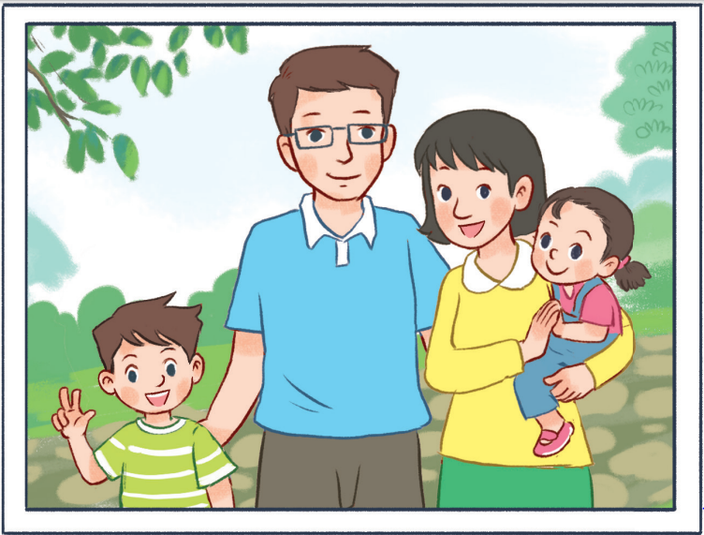
11
My family
LESSON 3 – PERIOD 5

Slide 4
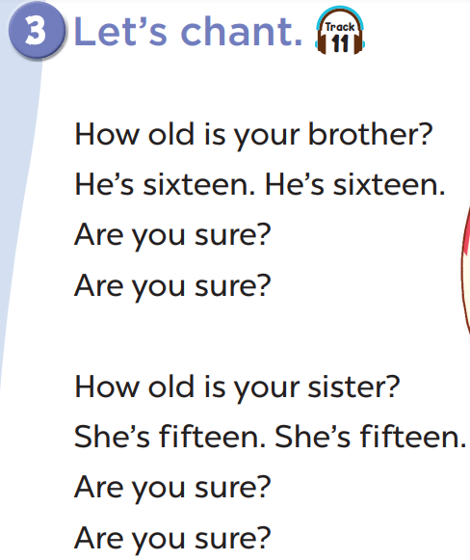
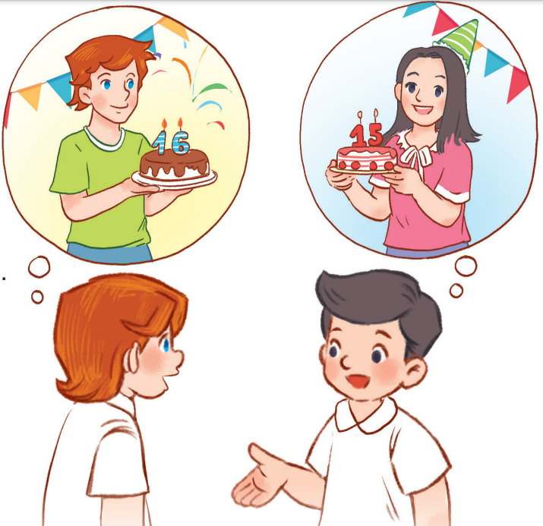

Slide 5
old
school
book
30
O /əʊ/
Notes:
- Click on the home button to go back.

Slide 6
go
come
about
20
O /əʊ/
Notes:
- Click on the home button to go back.

Slide 7
sure
black
blue
20
ure /ʊə(r)/
Notes:
- Click on the home button to go back.

Slide 8
Website: hoclieu.vn
Fanpage: facebook.com/www.tienganhglobalsuccess.vn

