Slide 1
Unit 15
OUR
HEALTH
Lesson 1 – Period 2

Slide 2
01
Warm-up and review.

Slide 3
02
Activity 4
Listen and number.

Slide 4
Look and answer.
Notes:
Step 1: Have pupils look at Activity 4. Ask them How many pictures are there? And What health problems can you see in each picture? Explain that they will write numbers 1 - 4 in the box of the picture in the order they hear.

Slide 5
Listen and number.
1
Notes:
Step 2: Play the recording of the first dialogue. Ask pupils to find the correct picture and write number 1 in the box. Check their answers and give feedback.

Slide 6
03
Activity 5
Read and complete.

Slide 7
Read and complete.
1. I feel tired. I have a _________________ .
headache
Notes:
Step 2: Have pupils read the sentences in Question 1. Ask them what is missing in the sentence. Ask them to complete the gap by finding the information from the picture. Give the correct answer.

Slide 8
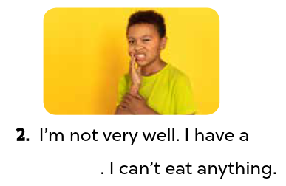
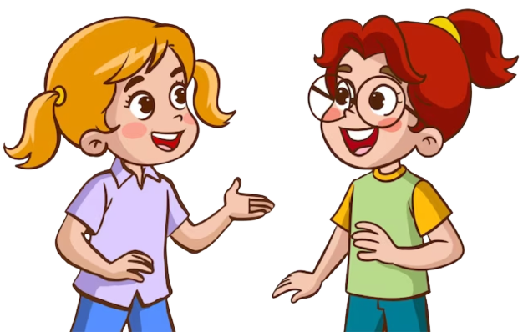
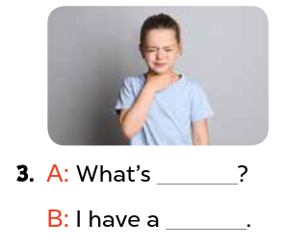
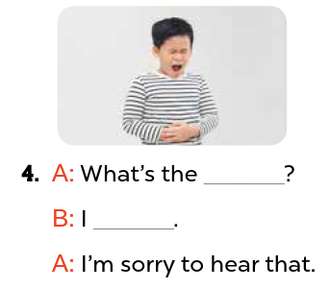
Read and complete.
Notes:
Step 3: Ask pupils to do the other questions in the same way individually, then in pairs for their peer-checks. Go around and give support if necessary.

Slide 9
04
Activity 6
Let’s sing.

Slide 10
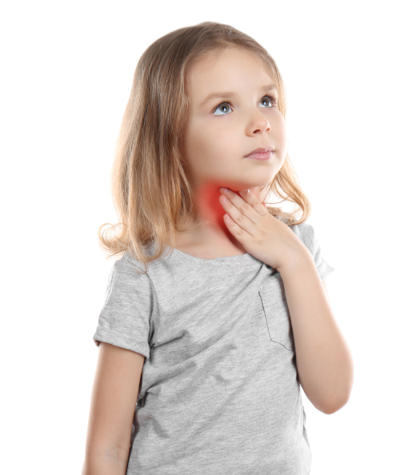
Listen and point.
Let’s play and sing.
I’m sorry. I can’t.
Why? What’s the matter?
I don’t feel well.
I have a sore throat.
Notes:
Step 3: Play the recording of the song once or twice for pupils to listen and repeat, line after line.

Slide 11
05
Fun corner and wrap-up.

