Slide 1
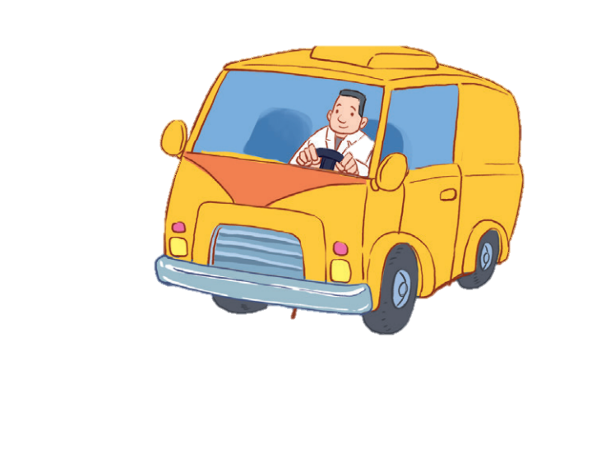
12
LESSON 1 – Period 1

Slide 2
1
Warm-up and review
Game: Memory game
Notes:
Step 1: Divide the class into 2 teams.
Step 2: Each pupil from each team goes to the front and touches 2 squares. If they match the right word with the correct picture, they will score one point for their team.
Step 3: Encourage pupils to join in the game.
Step 4: Give points for pupils.

Slide 3
MEMORY GAME
brother
father
grandpa
mother
grandma

Slide 4
EXIT
mother
father
brother
grandma
grandpa

Slide 5
Look, listen and repeat.
2

Slide 6
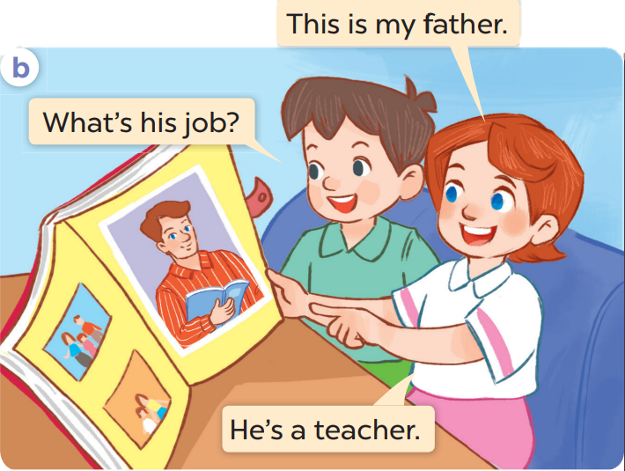
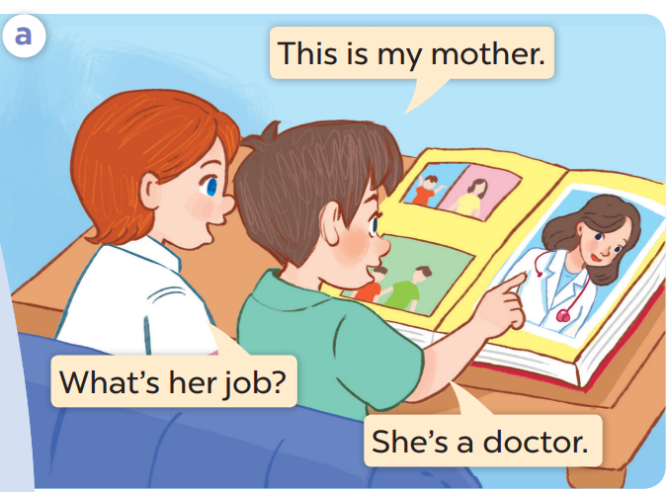

Slide 7
Listen, point and say.
3

Slide 9
4
Let’s talk.

Slide 10
5
Fun corner and wrap-up

